Slide 1

Weather Forecasting App
Bhujbal Knowledge City
MET’s Institute of Technology
Presented By:
Soumy Bagade
Sourav Mahajan
of Computer Science and Design Department
Guided By:
Prof. Gauri V. Sonawane
Prof. Swapnil Khairnar

Slide 2
Contents
Bhujbal Knowledge City
MET’s Institute of Technology
Abstract
Introduction
Literature Survey
Proposed System Architecture
Proposed Methodology
Implementation Details
Advantages & Disadvantages
Applications
Conclusion
References

Slide 3
Abstract
Bhujbal Knowledge City
MET’s Institute of Technology
The "Weather App" built using React JS allows users to check weather conditions of their desired location by fetching data from a weather API, providing a comprehensive tool for users to access weather information.
The app's core functionality includes fetching and displaying weather data such as temperature, humidity, wind speed, and precipitation, along with features like location search to enable users to view weather conditions for their desired location.
The app's user interface is designed using modular and reusable React components, ensuring a intuitive and user-friendly experience with clear and concise information displayed in an appealing format.
Building the Weather App requires a solid understanding of React concepts, JavaScript, and API integration, making it an excellent opportunity for developers to practice and enhance their skills while creating a functional and useful application.

Slide 4
Introduction
Bhujbal Knowledge City
MET’s Institute of Technology
Weather forecasting involves predicting atmospheric conditions at specific times and locations, utilizing science and technology to provide valuable insights for daily planning and decision-making.
Various factors like temperature, pressure, precipitation, wind speed, and humidity influence weather forecasting, making it a complex process that requires accurate data and analysis.
The primary goal of the weather app is to deliver precise weather forecasts and alerts to help users plan their daily activities, travel arrangements, and outdoor events effectively.
By integrating with reliable weather data sources like Visual Crossing Weather Map API, the app ensures the accuracy and timeliness of weather information, offering a user-friendly interface designed for simplicity, clarity, and efficient performance to enhance the user experience.

Slide 5
Literature Survey
Bhujbal Knowledge City
MET’s Institute of Technology
Ref.No. | Title | Implementation / Problem statement | Results
1 | ”Building Web Applications with React” by Philip Kiefer and David Pitt | Building web applications using React | This book provides a comprehensive guide to building web applications using React, covering topics such as component-based architecture, state management, and routing. It would be beneficial for understanding the fundamentals of React, which is a key technology in your project
2 | ”React Cookbook” by Carlos Santana Rold´an | Practical solutions and tips for common challenges faced in React development. | This cookbook offers practical solutions and tips for common challenges faced in React development. It covers topics like data fetching, handling forms, and integrating third-party libraries, which could be relevant for building features in your Weather Forecasting App.
3 | Weather Forecasting: A Practical Guide for Engineers and Scientists” by Ivan C. Gill | Overview of weather forecasting principles and techniques. | This book provides a comprehensive overview of weather forecasting principles and techniques. While it may not directly relate to the development aspect of your project, understanding the fundamentals of weather forecasting could help in interpreting and presenting weather data effectively in your application.

Slide 6
Proposed System Architecture
Bhujbal Knowledge City
MET’s Institute of Technology
The overall architecture of the Weather Forecasting App involves several components working together to provide users with accurate weather forecasts and a seamless user experience. Below is a description of the components, their functions, and how they interact with each other, along with a simplified diagram for visual understanding
Frontend Components:
React Components: These are the building blocks of the user interface (UI). Each
component represents a part of the UI, such as the weather display, search bar,
settings menu, etc. React components are responsible for rendering the UI based
on the app’s state and user interactions.
UI State Management: State management libraries like Redux or React Context
API can be used to manage the application state, including weather data, user
preferences, and UI state changes

Slide 7
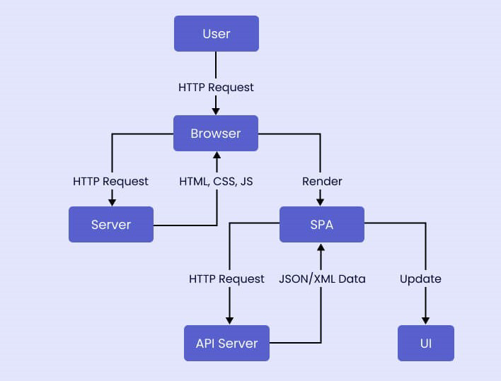
Proposed System Architecture
Bhujbal Knowledge City
MET’s Institute of Technology
Flowchart:

Slide 8
Proposed Methodology
Bhujbal Knowledge City
MET’s Institute of Technology
1. Environment Setup: First, you need to set up your development environment. This includes installing Node.js and npm (Node Package Manager), which are required to run a React application. You also need to install the create-react-app tool, which is a command-line utility for creating new React applications.
2. Project Initialization: Once your environment is set up, you can create a new React application using the create-react-app command. This will create a new directory with all the necessary files and dependencies for a basic React application.
3. Package Installation: Next, you need to install additional packages that are required for the application. In this case, you need to install the axios package, which is used to make HTTP requests from the application. This can be done using the npm install command.
4. Component Creation: After all the necessary packages are installed, you can start creating the components for your application. In this case, you need to create a Weather Forecast component, which is responsible for fetching and displaying the weather data.
5. Data Fetching: Inside the Weather Forecast component, you use the use Effect React hook to fetch the weather data when the component is first rendered. This is done using the axios.get method, which sends a GET request to the weather API.
6. State Management: The fetched data is stored in the component’s state using theuseState React hook. This allows the component to re-render whenever the data changes.

Slide 9
Implementation Details:
Bhujbal Knowledge City
MET’s Institute of Technology
The Weather Forecasting application was developed using a combination of modern web technologies, primarily JavaScript, React, and Vite.
1. Programming Languages:
React, a popular JavaScript library for building user interfaces, was chosen for its component-based architecture, which allows for efficient code reuse and better manageability. The application is structured into several React components, each responsible for a specific part of the user interface. For instance, components were created for displaying the weather forecast, handling user input, and managing the
application’s state.
• Vite, a next-generation front-end build tool, was used to speed up the development process. Vite provides a faster and leaner development experience compared to traditional build tools. It offers features like hot-module replacement and esbuild powered transpilation, which significantly improve the development experience.
• The application fetches weather data from a third-party API. To handle these asynchronous requests, the Axios library was used. Axios is a promise-based HTTP client for the browser and Node.js, and it’s known for its easy-to-use API and ability to handle requests and responses in a more user-friendly way.
• The application was styled using CSS, with the help of Autoprefixer, a postprocessor for CSS. Autoprefixer was used to ensure that the CSS rules work as expected in different browsers, even if they require vendor prefixes.
• The application was deployed using GitHub Pages. The deployment process was automated using npm scripts, specifically the ”gh-pages” package, which simplifies the process of deploying to GitHub Pages.

Slide 10
Bhujbal Knowledge City
MET’s Institute of Technology
2.Tools and Libraries:
• Redux or React Context API: For state management in the frontend, managing user preferences, weather data, and UI state.
• Axios: JavaScript library for making HTTP requests to fetch weather data from external APIs.
• Geolocation API: Browser API for retrieving the user’s current location coordinates.
• Weather Data APIs: Integration with weather data providers like OpenWeatherMap or Weatherstack for fetching weather forecasts.
• Chart.js or D3.js (Optional): Data visualization libraries for creating interactive weather charts, graphs, or maps.
3.Hardware and Software:
• Development Environment: Any modern computer with sufficient resources for development tasks.
• Operating System: Platform-independent development environment, compatible with macOS, Windows, or Linux.
• Web Browser: Testing and debugging on popular web browsers like Chrome, Firefox, and Safari.
• Text Editor or IDE: Development tools such as Visual Studio Code, Atom, or Web- Storm for coding and project management.

Slide 11
Advantages and Disadvantages
Bhujbal Knowledge City
MET’s Institute of Technology
Advantages:
1. The Weather Forecasting App using React and Vite offers several advantages that set it apart from existing solutions and address the problem of providing accurate and user-friendly weather information. Here are the key advantages of this project:
2. User-Friendly Interface: The app provides a simple and intuitive user interface that allows users to easily access weather information for a specific location. With features like tooltips and interactive elements, users can navigate the app effortlessly and quickly find the weather data they need.
3. Real-Time Weather Data: By integrating with APIs like Open-Meteo and Geocode, the app delivers real-time weather information to users. This ensures that users have access to up-to-date and accurate weather forecasts, enabling them to make informed decisions based on current conditions.
4. Customizable Location Settings: Users can search for weather information by city name or ZIP code, allowing for personalized weather forecasts based on their preferred locations. This customization feature enhances user experience and ensures that users receive relevant weather data for their specific areas of interest.
5. Interactive Features: The app offers interactive elements such as weather charts, maps using Leaflet, and tooltips for enhanced user engagement. These features not only make the app visually appealing but also provide users with a comprehensive view of weather conditions and forecasts.
6. Simulated API Calls: The project includes a directory with simulated API calls, allowing users to trial and edit data without the need for actual APIs or API keys. This feature enables developers to test and experiment with the app’s functionality easily, enhancing the development process.

Slide 12
Disadvantages:
Bhujbal Knowledge City
MET’s Institute of Technology
1. Limited Features: The app currently provides basic weather information for a specific location, such as temperature, humidity, and wind speed. It lacks advanced features like weather alerts, historical data, or detailed weather analysis, which could enhance the user experience and utility of the app.
2. Single Page Design: The app’s single-page design may limit scalability and flexibility for future expansion. Adding new features or additional pages could be challenging with the current architecture, potentially hindering the app’s ability to accommodate more complex functionalities.
3. Dependency on External APIs: The app heavily relies on external APIs like Open- Meteo and Geocode for weather and location data. Any changes or disruptions in these APIs could impact the app’s functionality, leading to potential downtime or inaccuracies in weather information.
4. Limited Location Options: The app currently allows users to view weather information For a specific location, with the default set to London, UK. Enhancing the App to support more location options, geolocation services, or user defined locations could improve its usability and appeal to a wider audience.

Slide 13
Bhujbal Knowledge City
MET’s Institute of Technology
Applications:
The Weather Forecasting App using React and Vite offers a range of potential applications in real-world scenarios, providing valuable weather information to users in various contexts. Here are the key areas where the app can be useful:
1. Agricultural Development: The app can be utilized in agricultural development, similar to the application discussed in the research article . Farmers can access real-time weather forecasts to plan their agricultural activities effectively, optimize crop management, and mitigate risks associated with adverse weather conditions.
2. Outdoor Activities Planning: Users engaging in outdoor activities such as hiking, camping, or sports can benefit from the app by checking weather forecasts to plan their activities accordingly. Knowing the weather conditions in advance can help individuals make informed decisions and ensure their safety during outdoor adventures.
3. Travel Planning: Travelers can use the app to check weather forecasts for their destination locations, helping them pack appropriate clothing, plan sightseeing activities, and make travel arrangements based on expected weather conditions. This can enhance the overall travel experience and minimize weather-related disruptions.
4. Event Planning: Event organizers can leverage the app to monitor weather forecasts for event venues, ensuring that outdoor events are scheduled during favorable weather conditions. By staying informed about weather predictions, event planners can make contingency plans and adjustments to ensure the success of their events.
5. Construction and Infrastructure Projects: Construction companies and infrastructure developers can use the app to monitor weather forecasts for project sites. By anticipating weather changes, they can plan construction activities, manage resources efficiently, and implement safety measures to protect workers and equipment from adverse weather conditions.

Slide 14
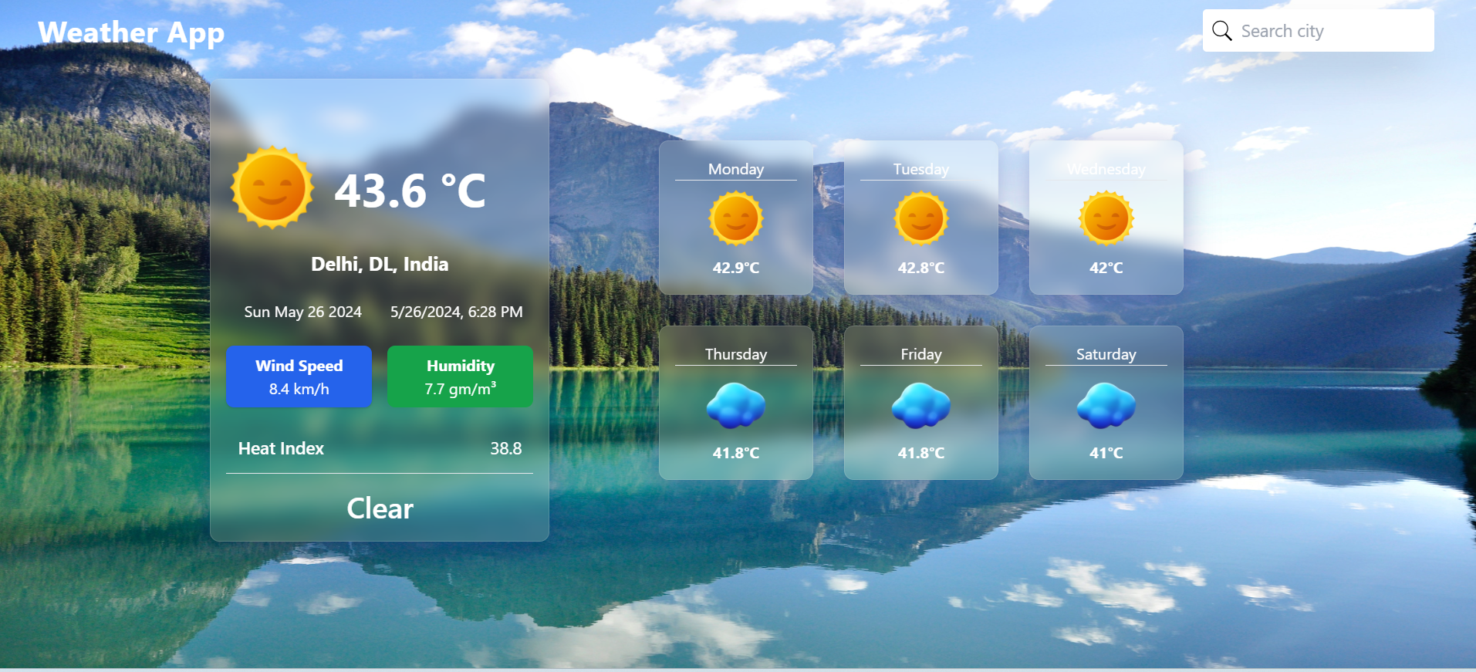
Bhujbal Knowledge City
MET’s Institute of Technology
WEBSITE LOOKS LIKE THIS:

Slide 15
Conclusion
Bhujbal Knowledge City
MET’s Institute of Technology
The Weather Forecasting App, developed using React and Vite, addresses the need for accurate and accessible weather information by providing users with a seamless and user-friendly interface to access real-time weather data.
The project's modular architecture, built using React components and Redux for state management, ensures maintainability, scalability, and reusability, allowing for easy integration of new features and modifications without compromising the overall application structure.
The app's integration with APIs like Open-Meteo and Geocode enables the fetching of weather and location data, delivering up-to-date forecasts for specific locations, while reducing the need for internal data maintenance and storage, leading to cost savings.
Although the reliance on external APIs introduces a potential limitation, as changes or disruptions in these APIs could impact the app's functionality, the project's modular architecture, user-friendly interface, and commitment to security make it a promising solution in the weather forecasting domain, with the potential to evolve and adapt to user needs over time.

Slide 16
References
Bhujbal Knowledge City
MET’s Institute of Technology
[1] Darsh Bhavnani, Om Goplani, Akshay Ahuja, Ishwari Nawathye, Sanjay Wankhade”WEATHER APP”
[2] Gaurav Kumar BHARTI, Abhijeet RANJAN , Anshul BHARAT , Suraj YADAV ”Design and Development of an Efficient and Intelligent Weather Forecasting App”
[3] M. N. H. Khan, M. A. Farukh and M. M. Rahman ”Application of Weather Forecasting Apps for Agricultural Development”
[4] https://updevcommunity.com/en/articles/creating-and-testing-a-simple-weatherapp-in-reactjs:-a-step-by-step-guide
[5] https://www.geeksforgeeks.org/create-a-real-time-weather-forecast-app-with-react/
[6] https://revolugame.com/p/lets-build-a-weather-app-with-vite-and-react-part-3/
[7] Cahir, J. J. 2013. Weather Forcasting.Encyclopedia Britannica.Craft, E.D. 2010. An economic historyof weather forecasting. The Economic History Association.
[8] https://www.geeksforgeeks.org/weather-application-using-reactjs/
[9] https://dianapps.com/blog/how-to-create-a-weather-app-using-the-react-nativeframework/
[10] https://www.yourteaminindia.com/blog/build-weather-app-in-reactjs

